Slide 1


CMR Technical Campus
UGC AUTONOMOUS
Accredited by NAAC with A Grade
Approved by AICTE, New Delhi and Affiliated to JNTU, Hyderabad
Department of Computer Science and Engineering
Final Review
A Major Project on
STROKE RISK PREDICTION USING MACHINE LEARNING ALGORITHMS
BATCH NO:12
UNDER THE GUIDANCE OF:
K.SHILPA
(Assistant Professor)
Presented by:
207R1A05D4 HEMA BINDU
207R1A05E7 KAREMI TEJA
207R1A05D2 CH.NAVATEJ

Slide 2
CONTENTS:
Abstract
Existing system
Disadvantages
Proposed system
Advantages
Requirements
Architecture
UML Diadrams
Conclusion
References

Slide 3
ABSTRACT:
In this Project developing the web application for predicting stroke of a person, the project is majorly for stroke risk prediction.
As the death caused by stroke is increasing day by day, so it is very important to predict the stroke earlier.
So developing the web application helps us to prevent the life of a person caused by stroke.
The application Predict the Risk caused by a person is done by using the Machine Learning algorithms.

Slide 4
EXISTING SYSTEM:
In the Existing system, there is no application to detect the stroke and prevent the life of patient. And it got difficult in saving the life of a patient.
There is proper information about the health details of the patients.
There is no proper information to detect stroke and become more difficult to detect the stroke.
No website, only the manual research was done.

Slide 5
DISADVANTAGES:
In the existing system as there is not implementation of the application it is more difficult to detect the stroke.
And the detection of stroke of patient become more difficult and may lead to death.
Consumption of time is more.

Slide 6
PROPOSED SYSTEM:
In the proposed System , after many experiments a web Application has been created using Machine Learning algorithms.
The application is created by taking data from many websites.
The applications takes various inputs of every particular patient details like blood pressure and heart rate and the details of any previous stroke of that patient to prevent the stroke.

Slide 7
ADVANTAGES:
Using this Machine Learning algorithms it take less time for prediction.
Patient stroke can be predicted easily.
These algorithms makes more accurate application and efficiency.

Slide 8
REQUIREMENTS:
SOFTWARE REQUIREMENTS:
Operating System : Windows 7.1 /10
Programming Language : Python
Fronted Technologies : HTML , CSS , JavaScript
Backend Technologies : MySQL
Framework : Django
HARDWARE REQUIREMENTS
Processor : Intel Dual Core I5 and above
Hard disk : 20GB and above
RAM : 4GB and above

Slide 9
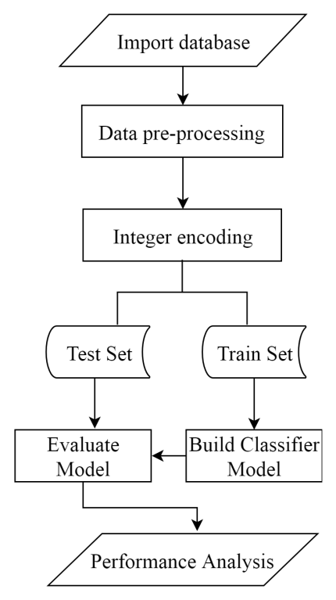
ARCHITECTURE:

Slide 10
CLASS DIAGRAM:

Slide 11
USE CASE DIAGRAM:

Slide 12
SEQUENCE DIAGRAM:

Slide 13
ACTIVITY DIAGRAM:

Slide 14
CONCLUSION:
The aim of this paper was to predict the stroke of a person in advance to prevent life of a person.
Our dataset of 200 records was used with the cross-validation technique with 4 folds. It contains the details like blood pressure, heart beat, patient name, patient age, previous details of patient like previous operation details.
It uses five machine learning algorithms and among those Naïve Bayes algorithm gives high accuracy.
This system will be very useful to predict the stroke of person earlier and save the life of patient.

Slide 15
REFERENCES:
[1] S. H. Pahus, A. T. Hansen, and A.-M. Hvas, “Thrombophilia testing in young patients with ischemic stroke,” Thrombosis research, vol. 137, pp. 108–112, 2016.
[2] P. Govindarajan, R. K. Soundarapandian, A. H. Gandomi, R. Patan, P. Jayaraman, and R. Manikandan, “Classification of stroke disease using machine learning algorithms,” Neural Computing and Applications, pp. 1–12.
[3] L. T. Kohn, J. Corrigan, M. S. Donaldson, et al., To err is human: building a safer health system, vol. 6. National academy press Washington, DC, 2000.
[4] R. Jeena and S. Kumar, “Stroke prediction using svm,” in 2016 International Conference on Control, Instrumentation, Communication and Computational Technologies (ICCICCT), pp. 600–602, IEEE, 2016.
[5] P. A. Sandercock, M. Niewada, and A. Członkowska, “The international stroke trial database,” Trials, vol. 13, no. 1, pp. 1–1, 2012.

Slide 16


